Slide 1


Digital Logic and Design

Slide 2


Slides can be found at
https://github.com/sajjo79/Digital-Logic-Design

Slide 3
Storage Elements: Latches
Chapter 4: Sequential circuits

Slide 4
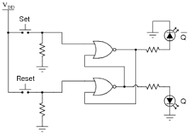
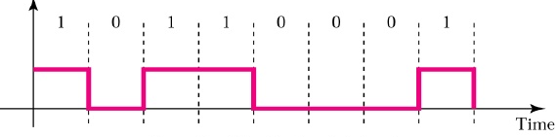
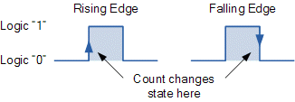
Introduction
A storage element(SE) can contain binary information stored in it as long as power is supplied
The stored information is only changed if input supplied to SE is changed
There are different types of storage elements
SR Latch, D-Latch, Flip-Flop, ….
The major difference among these types is the number of inputs, the way to change the state of SE
SE can be operated either with signal levels or with clock edge
Latches: SE operated with signal level. These are level sensitive devices
Flip-flops: SE operated with clock. These are edge sensitive devices
Latches are basic circuits which are also used to build Flip-Flops

Slide 5
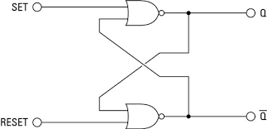
Introduction
Latches are useful for
Storing binary information
Design of asynchronous circuits
Latches can cause serious timing problems in sequential circuits
The timing problems can be prevented by using “Flip-Flops”
SR Latch

Slide 6
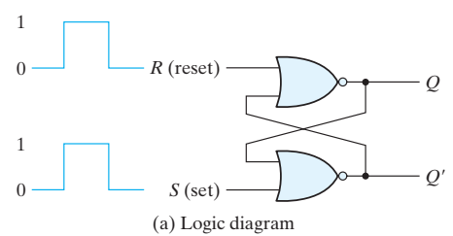
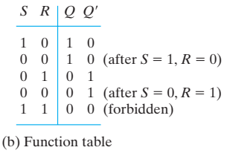
SR-Set/Reset Latch
SR Latch is a two cross coupled NOR or NAND gate circuit with
Two inputs S (Set), R(Reset)
Two outputs Q and Q’.
The latch has two useful states: Set and Reset
Set state: output Q = 1 and Q’ = 0
Reset State: Q = 0 and Q’ = 1.
Stable State: S=0, R=0
Outputs Q and Q’ are normally the complement of each other. However, when both inputs are equal to 1 at the same time, both outputs become equal to 0
If both inputs are then switched to 0 simultaneously, the device will enter an unpredictable or undefined state or a metastable state.
In practical applications, setting both inputs to 1 is forbidden.

Slide 7
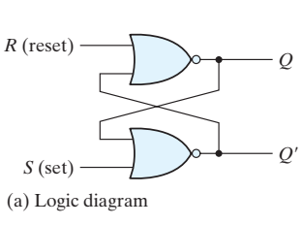
Reading the Circuit
In start both inputs of the latch remain at 0 unless the state has to be changed.
The application of a momentary 1 to the S input causes the latch to go to the set state.
The S input must go back to 0 before next changes to avoid the occurrence of an undefined next state that results from the forbidden input condition.
Two input conditions cause the circuit to be in the set state
S = 1, R = 0 : is the action that must be taken by input S to bring the circuit to the set state.
S=0, R=0 : Removing the active input from S leaves the circuit in the same state.
S=0, R=1: is the action that is taken to bring latch in reset state
S=0, R=0 : Removing the active input from R leaves the circuit in the same state.
When both inputs S and R are equal to 0, the latch can be in either the set or the reset state

Slide 8
Forbidden State of SR Latch
S=1, R=1: both outputs Q,Q’=0
This produces an undefined next state, because the state that results from the input transitions depends on the order in which they return to 0.
S=0,R=0: will Q =1 or Q’=1 or Q=1 and Q’=1
this violates the requirement that outputs be the complement of each other.
It is avoided by making sure that 1’s are not applied to both inputs simultaneously

Slide 9
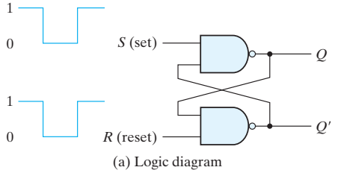
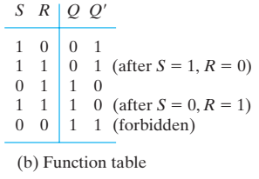
SR Latch with NAND gates
In start both inputs are 1, unless the state of the latch has to be changed.
Set State: S=0,R=1
Stable State: S=1, R=1
Reset State: S=1, R=0
Stable State: S=1, R=1
Forbidden State: S=0, R=0

Slide 10

Comparison of SR and S’R’ Latch
Signals required to NAND implementation are complement of NOR implementation
NOR implementation is called the SR implementation
NAND implementation is called the S’R’ implementation

Slide 11
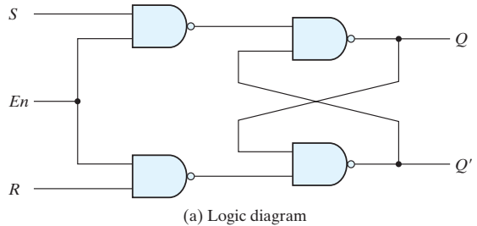
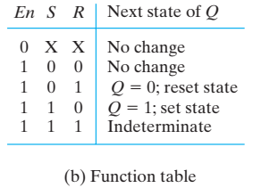
Controlling the operation of SR Latch
The change in SR state can be controlled by introducing an additional input
It consists of the basic SR latch and two additional NAND gates.
The control input En acts as an enable signal for the other two inputs.
En=0: The outputs of the NAND gates stay at the logic-1. Circuit is disabled
En=1: information from the S or R input is allowed to affect the latch.
Set state: S = 1, R = 0, and En = 1
Reset state: S = 0, R = 1, and En = 1.
Stable states:
En = 0, the circuit remains in its current state.
En = 1 and both the S and R inputs are equal to 0, the state of the circuit does not change.

Slide 12
Indeterminate Condition
Indeterminate condition: when all three inputs are equal to 1.
It places 0’s on both inputs of the basic SR latch, which puts it in the undefined state.
When the enable input goes back to 0, one cannot conclusively determine the next state, because it depends on whether the S or R input goes to 0 first.
This indeterminate condition makes this circuit difficult to manage, and it is seldom used in practice.
The SR latch is an important circuit because other useful latches and flip-flops are constructed from it.

Slide 13
13
Thanks for watching
Dr. Sajid Iqbal
Assistant Professor
Department of Computer Science
Bahauddin Zakariya University, Multan
Allah Hafiz
Slides are available at: https://github.com/sajjo79/Digital-Logic-Design

